Slide 1
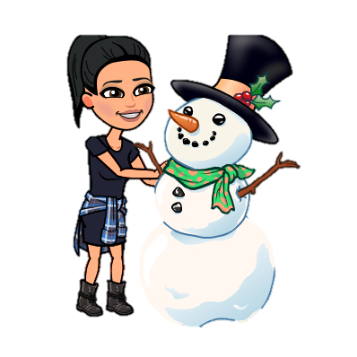
Week of 4/27-5/1
Monday | Tuesday | Wednesday | Thursday | Friday
20 minutes Imagine Learning 20 minutes Imagine Math Unit 8 Week 3 Benchmark packet pages HW math pages 101-102 Subitize Math Song Scholastic Let’s Find Out Magazine Read Aloud Classroom password is sskinderleao Busy, Buzzy Bees Optional Practice Google Classroom Reflex Math | Benchmark Advance Online ThinkCentral Lessons My Shared Reading: The Yellow Mitten pg. 22 HW math pages 103-104 Read: Val is a Vet Draw and write about your favorite page. Lined paper Brainpop Jr. Reduce, Reuse, & Recycle Discuss: What is waste? How do we reuse? How do we recycle? Optional Practice Google Classroom Khan Math | 20 minutes Imagine Learning 20 minutes Imagine Math Unit 8 Week 3 3 Benchmark packet pages 1 math page (Blue book in Kinder Bundle) Weather Book: complete 1-2 pages Listen to the story One Snowy Day Retell Key Events: Beginning, Middle, and End | Benchmark Advance Online ThinkCentral Lessons My Shared Reading: Snow City pg. 24 HW math pages 105-106 Letter Aerobics Scholastic ScienceSpin Read Aloud Classroom password is sskinderleao Let’s Move! Push and pull Optional Practice Google Classroom Reflex Math | 20 minutes Imagine Learning 20 minutes Imagine Math Unit 8 Week 3 3 Benchmark packet pages 2 math pages (Blue book in Kinder Bundle) Zoom Meeting LETTER Vv OR Qq • Red 9:00-9:20 • Orange 9:25-9:45 • Green 9:50-10:10 • Blue 10:15-10:35 • Purple 10:40-11:00 Optional Practice Google Classroom Khan Math

